Slide 1


Year 6 Information Meeting

Slide 2
Agenda
Provide information on Year 6 SATs
Share how we prepare the children
An opportunity to look at examples of the tests taken by your children
Share ideas of how you can support your child
An opportunity to ask any questions that you might have

Slide 3

What are the SATs?
KS2 SATs (National Curriculum Tests) are tests children take at the end of Year 6. SATs test children on what they have learnt during their time at Primary School.
KS2 SATs are mandatory tests from the National Curriculum assessment programme. All state schools in England are required to provide the tests.
They are marked externally and the results sent to schools.

Slide 4
Date | Assessment
Monday 12th May 2025 | Spelling, Punctuation and Grammar – Paper 1 Spelling, Punctuation and Grammar – Paper 2
Tuesday 13th May 2025 | English Reading
Wednesday 14th May 2025 | Maths Paper 1 (Arithmetic) Maths Paper 2 (Reasoning)
Thursday 15th May 2025 | Maths Paper 3 (Reasoning)

Slide 5
The English Tests
Reading - 50 marks – 1 hour
Grammar, Punctuation and Spelling Test – 50 marks – 45 minutes
Spelling test – 20 words – 15 minutes
Writing - A Teacher Assessment of each child’s writing ability will be made in May/June 2025

Slide 6
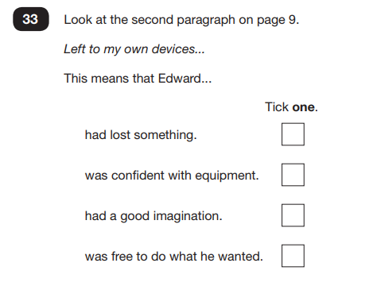
The Reading Test
Some questions will test the children on their understanding of vocabulary.

Slide 7
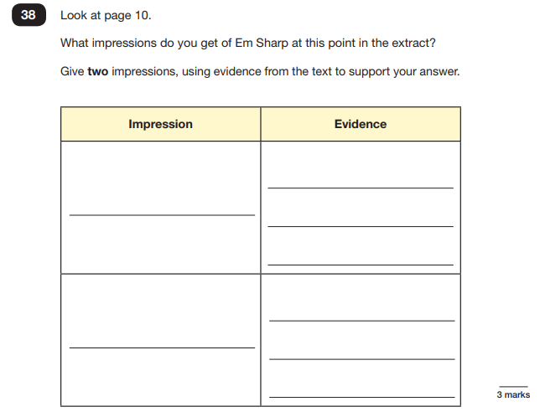
Others will require the children to infer answers by using words or phrases as evidence.

Slide 8
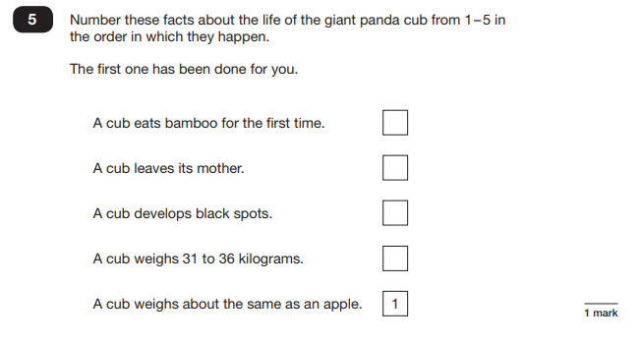
Some questions will ask the children to find literal answers from the texts.

Slide 9
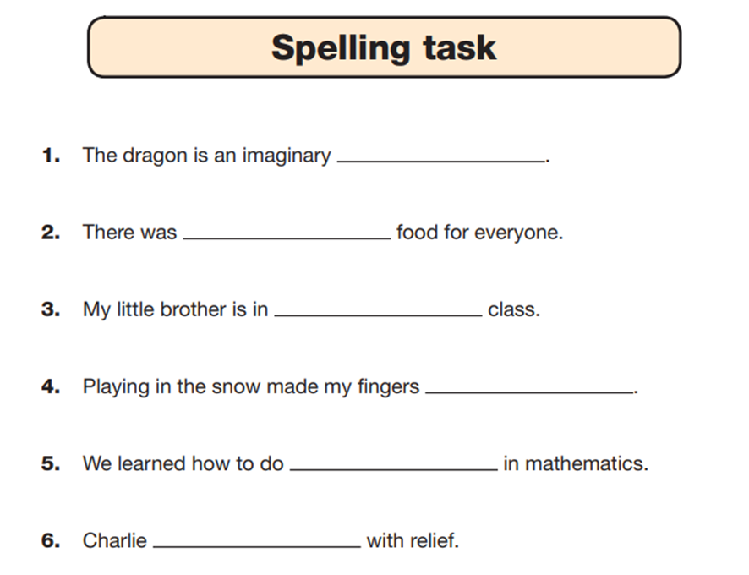
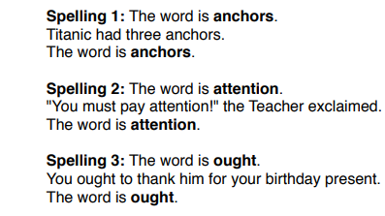
Grammar, Punctuation and Spelling
Notes:
The Grammar, Punctuation and Spelling Test:
There is a specific focus on knowing and applying grammatical terminology with the full range of punctuation tested.
Technical terms in grammar will be tested.
There will be one test paper for grammar, punctuation and vocabulary and one test paper for spelling.
The grammar test will last for one hour and there will be a total of 50 marks available.
In the grammar test, two thirds of the marks will be for multiple choice questions. The remaining questions will require pupils to write a longer answer.
There are 20 spelling sentences.
The spelling words are tested within the context of a sentence.
As the sentences are read out to the children,
they fill in the correct spellings on their copy of
the text.

Slide 10
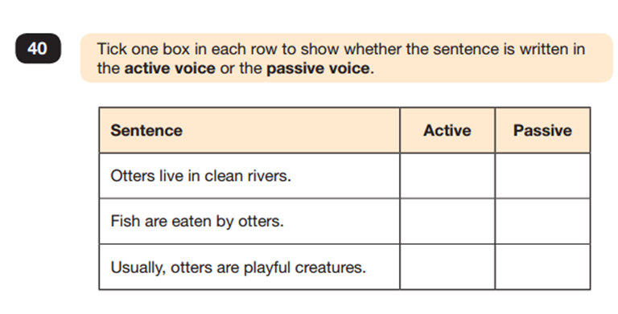
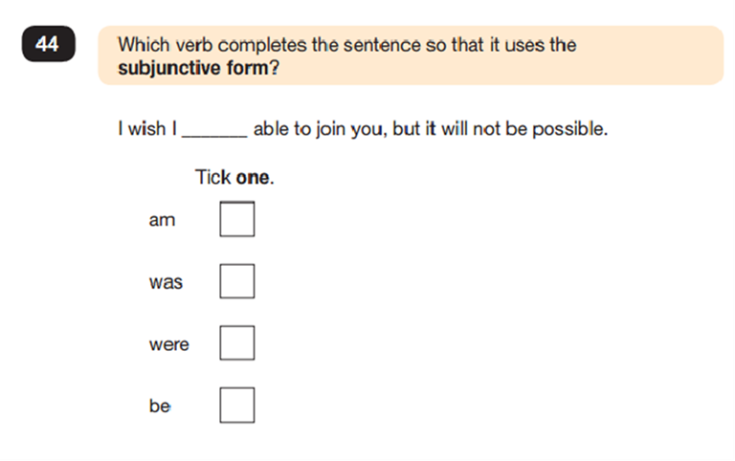

Slide 11
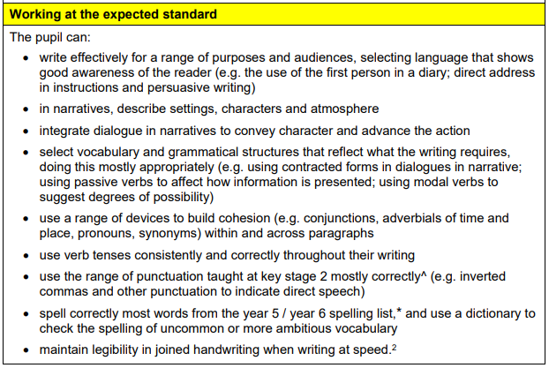
Writing
Notes:
Writing is assessed differently to all other areas. There is no writing SAT. Instead throughout the year:
Teachers assess children’s writing in a range of different genres,
Children's grammar, punctuation and spelling skills will be assessed as part of their writing along with their creativity and writing style,
Schools will moderate their judgements with other local schools and may be moderated by their Local Authorities too.
For writing, we will then report our decisions at the end of the year in terms of children:
• working towards the expected standard
• working at the expected standard
• working at greater depth within the expected standard

Slide 12
Maths
Arithmetic Test
There will be 36 questions in the arithmetic test worth a total of 40 marks.
The test will last 30 minutes.
Mathematical Reasoning Papers
There will be two mathematical reasoning papers.
Each paper will be of 40 minutes duration with a total of 35 marks per paper available.
Notes:
There will be three papers: 1 arithmetic paper and 2 mathematical reasoning papers.
Questions in the arithmetic test will cover:
mental calculations
straight forward addition and subtraction
more complex calculations with fractions
long division and long multiplication

Slide 13
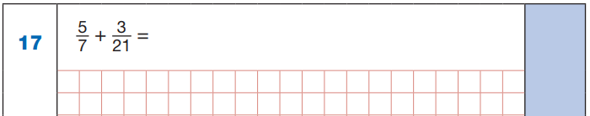
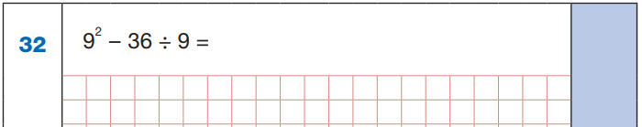

Questions taken from Paper 1 - Arithmetic

Slide 14
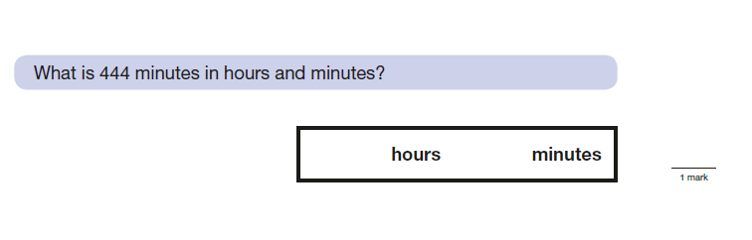
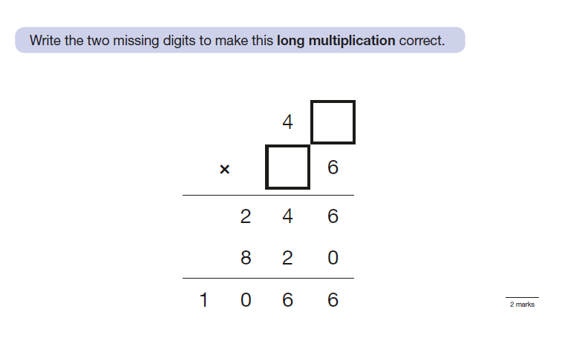
Questions taken from Paper 2 - Reasoning

Slide 15
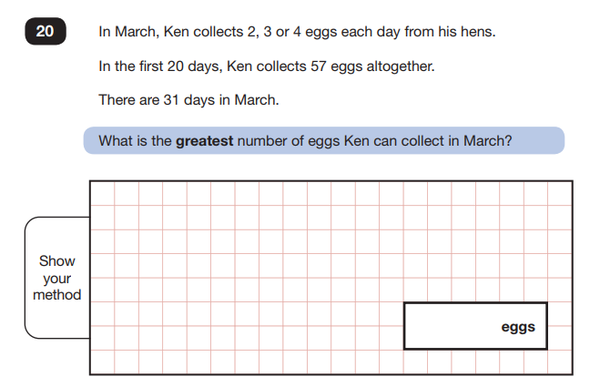
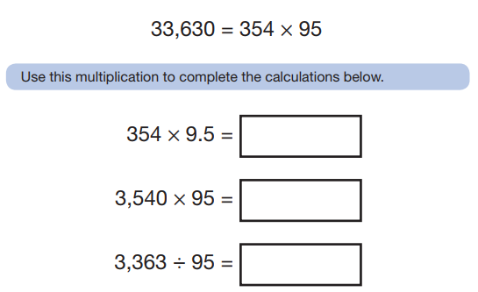
Questions taken from Paper 3
- Reasoning

Slide 16
Reporting the Results
Scaled Scores
All test outcomes at KS2 will be reported as scaled scores and you will be told whether or not your child has met the expected standard.
The national (expected) standard will be 100.
Raw scores (the number of marks awarded for each subject) will be translated to scaled scores using a conversion table devised by the DFE.
You will be given your child’s scaled score and whether they have reached the expected standard set by the Department for Education.
Notes:
Scaled Scores Examples:
A child awarded a scaled score of 100 is judged to have met the ‘national standard’ in the area judged by the test.
A child awarded a scaled score of 112 is judged to have exceeded the national standard and demonstrated a higher than expected knowledge of the curriculum at the end of the key stage.
A child awarded a scaled score of 94 is judged to have not yet met the national standard and indicates that the child may need more support to help them reach the expected standard.

Slide 17

How are we preparing your children?
Notes:
Continuous Assessment – identifying the gaps and helping to fill them
Focused (timed) arithmetic lessons
Focused GPS lessons (Spelling, Punctuation & Grammar)
Guided and Independent Reading
Writing Assessments carried out regularly – pupils involved in this process
Practising previous SATS papers
Teaching ‘test techniques’ and vocabulary
Home Learning to support teaching & learning in school
Booster groups and intervention groups
Keeping up to date with information provided by the DfE

Slide 18

How can you help?
Notes:
Remember your child's education is a partnership. Meet with teachers at parents’ evenings and see how they believe you can help.
Support your child with their homework.
Read regularly and discuss a variety of texts – don’t just listen to your child read.
Try short bursts of arithmetic practice and recalling times tables facts.
Practise telling the time and problem solving etc.
Regularly practise the year 5/6 key words/spellings.
Use websites and online activities to practise skills.
Encourage your child to believe in themselves, “You can do it!“
Do not put your child under too much pressure. Have fun, they will find things easier to remember if they remember the good times they had learning.
Help children to relax and do things that are not related to school.

Slide 19
How can I support my child?
Support your child to complete any home learning tasks sent home.
Each week they are expected to go on IXL, TT Rockstars, WWN, Spelling Shed and SPAG.com
Listen to them read and talk about the book they are reading.
Talk about the story before, during and afterwards – discuss the plot, the characters, their feelings and actions, how it makes you feel, predict what will happen and encourage your child to have their own opinions.
Speak to your child’s teacher if you notice any topics they are struggling with at home when completing homework.
CGP books
If you would like extra revision materials for your child, the CGP revision books are helpful.

Slide 20
How can I help my child in SATs week?
Encourage your child to talk to their teacher or a trusted adult (including yourself) about their anxieties.
Remind your child that SATs focus on what children know about Maths and English.
They will not reflect how talented they are at science, geography, art, PE…, and they certainly won’t highlight all of their amazing personal characteristics.
Make sure they go to bed at a reasonable time, have a good breakfast and arrive at school on time during the assessment week.
Encourage them to try their best, commend their efforts and plan to celebrate their hard work at the end of the testing week, rather than focusing on the test results.

Slide 21


Slide 22

READING

Slide 23
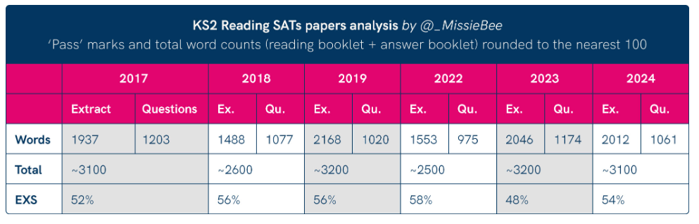

Slide 24
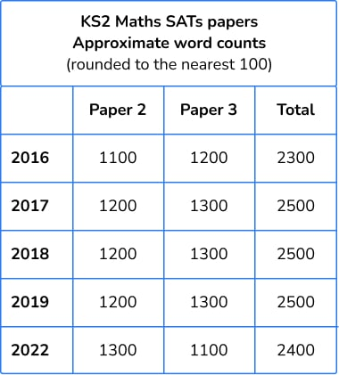

Slide 25

SOCIAL MEDIA

Slide 26


Wellbeing and mindfulness
We are working closely with the Mental Health Support Team, who will be running group and class workshops helping the children to find strategies to regulate and build their emotional resilience!

Slide 27
THIS YEAR, We recommend…
Early nights and lots of sleep
Good punctuality
A good breakfast every day
A positive attitude - encourage your child to embrace the mistakes that they make and to learn from them
Lots of praise and encouragement
and most importantly…..

Slide 28

Good Attendance!!

Slide 29
The Statistics
Year 6 attendance this year:
92.7%
There have been 224 days off since September.
That’s 1,232 hours of learning missed!

Slide 30







Resources to help at home

Slide 31


